Slide 1

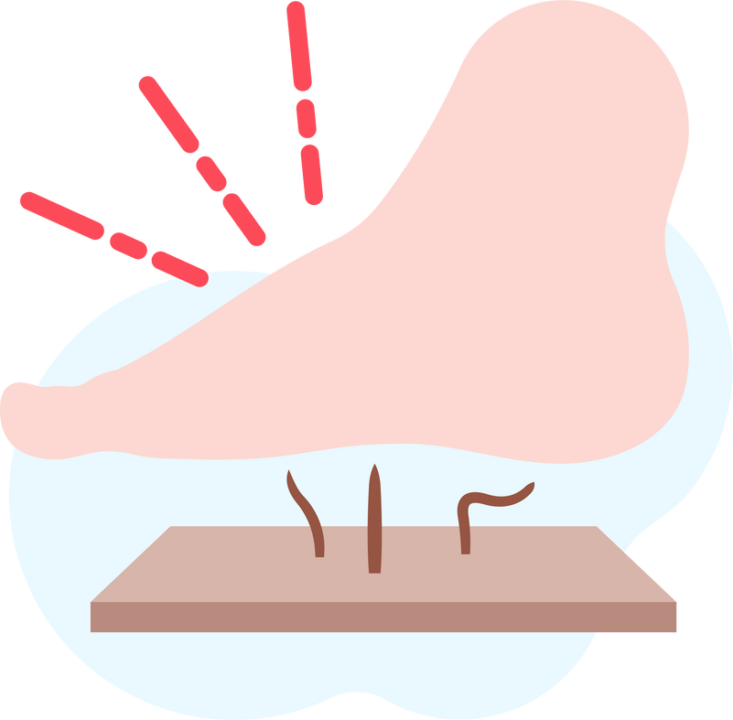



Lightning Talk 5:
Detailed Design
PRESSURE SENSOR PATCH
sdmay25-12
Advisor: Santosh Pandey
Client: BAE Systems

Slide 2
Project Overview
Objective
Target Users
Core Functionality
Key Features
Develop a pressure sensor patch for adaptive sports athletes to monitor pressure levels and prevent pressure sores.
Wireless connectivity to mobile devices, customizable pressure thresholds, and continuous monitoring, even when the app is closed.
Athletes with traumatic injuries at risk of pressure sores
Real-time data collection, processing, and alert system via an app.

Slide 3
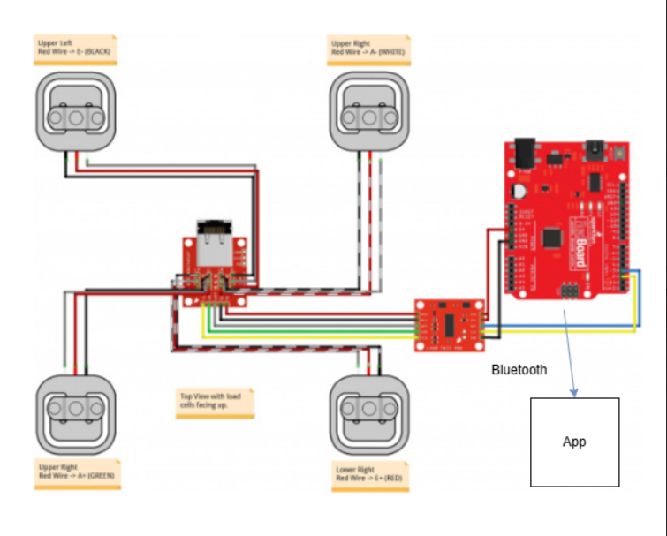
Detailed Design & Visuals
Our design consists of three major components that interact with each other. The first component is the load cell array, an array of weight sensor bundles that will monitor pressure in different areas. This system is then hooked up to a microcontroller which will process the output from the load cell array and turn this into usable data about the pressure in different regions. The microcontroller will include a Bluetooth module connecting to a mobile device.
Notes:
Our design consists of three major components that interact with each other. The first component is the load cell array, an array of weight sensor bundles that will monitor pressure in different areas. This system is then hooked up to a microcontroller which will process the output from the load cell array and turn this into usable data about the pressure in different regions. The microcontroller will include a Bluetooth module connecting to a mobile device.

Slide 4
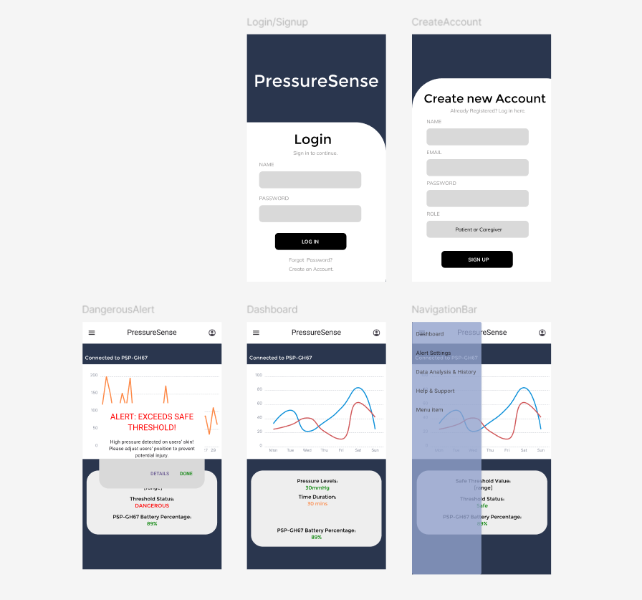
Detailed Design & Visuals
From here, an app will read the Bluetooth output from the microcontroller and display this information visually, pushing out notifications to the user if the pressure exceeds a predefined threshold. These notifications will be sent from the Bluetooth module to the mobile device so the app does not have to constantly run and process large amounts of data in the background.
The wireframes are for the app portion of the solution. These show high-level details about what the sensor is reading. The app also alerts when a reading is too high and the patient needs to shift their position.

Slide 5

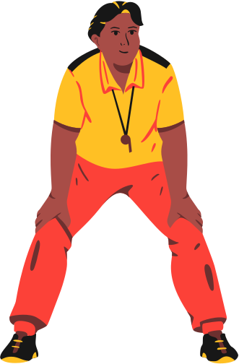



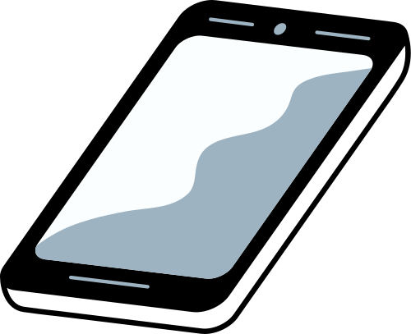



Functionality
Caregiver/User will be notified and be advised to shift body weight/position.
The pressure sensor mat sense user’s pressure level exceeds safe threshold

Slide 6
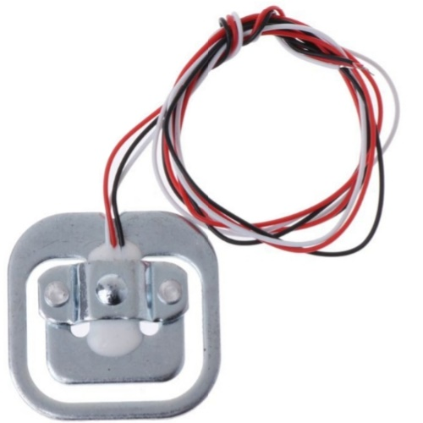
Technology Considerations
Load Cell Array:
Strengths:
High sensitivity to pressure variations, allowing for detailed monitoring across different regions.
Weaknesses:
Load cells can be sensitive to movement and may require calibration over time to maintain accuracy.
Trade-offs:
Load cells provide accurate pressure data but can be bulkier and require careful placement for consistent readings.
Alternative:
FlexiForce or piezoelectric sensors, which are more flexible but may sacrifice some accuracy.

Slide 7
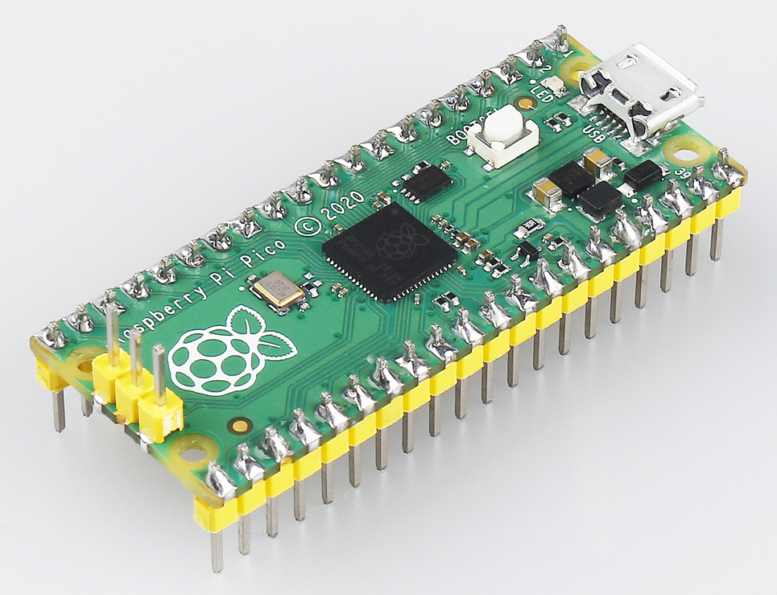
Technology Considerations
Microcontroller with Bluetooth Module:
Strengths:
Efficiently processes data locally and transmits only essential notifications, conserving power and bandwidth.
Weaknesses:
Bluetooth connection reliability can vary, especially in high-movement or long-range situations.
Trade-offs:
Bluetooth offers low-energy communication, but range and stability are factors that may affect responsiveness.
Alternative:
Wi-Fi modules offer better range but consume more power, reducing device portability.

Slide 8
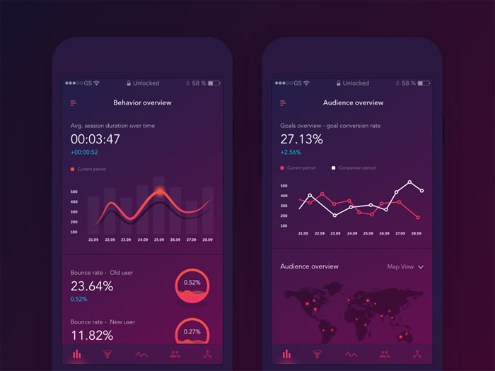
Technology Considerations
Mobile App:
Strengths:
User-friendly interface that provides immediate, actionable feedback; app notifications allow for proactive position adjustments without continuous app monitoring.
Weaknesses:
App dependency on mobile device capabilities and Bluetooth stability for notifications.
Trade-offs:
A simplified interface ensures ease of use but limits detailed data analysis directly within the app.
Alternative:
Developing additional data visualization for advanced users, potentially adding a desktop interface for more extensive data review.

Slide 9
Areas of Concern & Development
Current Design Fit
The design largely satisfies requirements for real-time pressure monitoring and user notification. The load cell array captures detailed pressure data across multiple regions, and the Bluetooth-enabled microcontroller efficiently transfers data to the app, which alerts users when pressure exceeds a safe threshold. This approach meets the core need of injury prevention by notifying athletes in real time.
User Needs Met:
The device provides non-intrusive, proactive monitoring, fitting into the active lifestyle of adaptive sports athletes. The app interface is designed to be intuitive, allowing users to easily monitor pressure and receive alerts as needed.

Slide 10
Areas of Concern & Development
Primary Concerns
Sensor Durability and Accuracy:
In high-impact sports, sensors may be subject to wear, potential misalignment, and signal interference, which could reduce accuracy over time.
Battery Life and Bluetooth Stability:
Maintaining a reliable Bluetooth connection and sufficient battery life in high-activity settings is essential, but challenging, especially if athletes are moving frequently or using the device outdoors.
User Adoption and Usability:
Ensuring the device and app are simple to use in dynamic sports contexts will be critical for user adoption. Complex interfaces or frequent recalibration may deter use.
Mitigation Strategies:
Test various protective casings for sensors, explore extended battery options, and prioritize app interface simplicity to ensure continued functionality and ease of use.

Slide 11

Conclusion
The pressure sensor patch design is on track to meet primary requirements and user needs by combining precise monitoring with a straightforward, real-time notification system.
Future work will focus on durability testing, refining Bluetooth connectivity, and app usability improvements to ensure long-term reliability and user satisfaction. By addressing these concerns, the project aims to deliver a dependable tool for athletes to protect against pressure-related injuries.

